Slide 1

Boston Housing Price Prediction

Slide 2
Table of Contents
Overview
Data Exploration
Data Preprocessing
Developing a Model
Linear Regression
Random Forest
Decision Tree
XGBoost Regressor
Extra Tree Regressor
Hypertuning Random-Forest
Results
Conclusion

Slide 3
Overview
The Boston housing data was collected in 1978 and each of the 506 entries represent aggregated data about 14 features for homes from various suburbs in Boston, Massachusetts.
The Purpose of this project is to make a model which can predict the prices of the houses effectively based on given parameters.
A model trained on this data that is seen as a good fit could then be used to make certain predictions about a home — in particular, its monetary value.
This model would prove to be invaluable for someone like a real estate agent who could make use of such information on a daily basis.

Slide 4
Data Exploration
Initial look at the dataset gives us below information:
- The data as no NAN/Null values, data type is float for all columns, there is no categorical value in the dataset (except for column name).
The columns include : Crime Rate, Pupil to Teacher Ratio,Tax, Percent of lower status of population, etc.
When Visualized and Analyzed, below can be concluded regarding the data
1. Percent of lower status of population and Average Room are the most important features for prediction of Price
2. Second in line will be Tax and Pupil-Teacher ratio in town
This was concluded by analyzing the dataset using visualization and by using Extra Tree Regression.
LSTAT and Average Rooms:
-For a higher LSTAT, we would expect to observe a a lower MEDV and for more Rooms we can observe a Higher MEDV

Slide 5
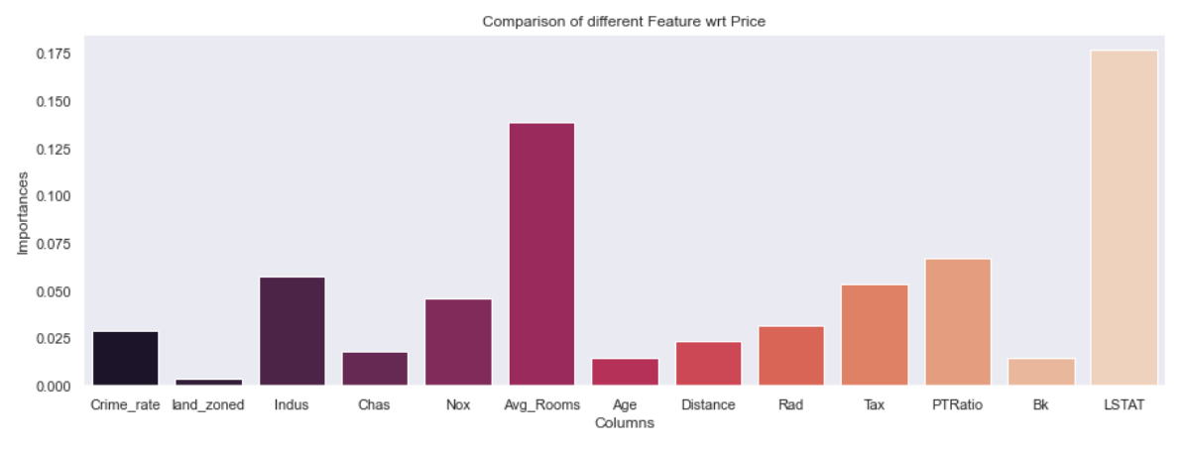
PTRatio is the ratio of pupil to teacher and the Price is inversely proportional to this value as this is because there would be a lower teacher-to-student ratio resulting in less attention dedicated to each student that may affect their performance in school.
The below Plot shows how much impact these features will have on the output i.e Price

Slide 6
Data Preprocessing.
Most of the values in the dataset were in floats and in the range of 0-1.But some values like Age,Indus,Distance, Average Rooms were whole number and greater than 1.
Here the data was Scaled using Standard Scalar:
The idea behind StandardScaler is that it will transform your data such that its distribution will have a mean value 0 and standard deviation of 1.
In case of multivariate data, this is done feature-wise (in other words independently for each column of the data).
There was no removal of outliers as the dataset had only 506 rows, with less data the model could overfit.

Slide 7
Developing a Model
The dataset was split and 80% of data was used for Training and 20% was used for testing.
Models used were :
1. Linear Regression: Utilizes “best fitted line” to make the predictions.
2. Random Forest : An Ensemble Technique
3. Extreme Gradient Boosting(XGBOOST)
4. Decision Tree
Accuracy : Utilized Root Mean Squared error , Mean Squared Error , R2 Score to understand the efficiency of the model
The Histogram of the Residual is used to check whether the variance is normally distributed.

Slide 8
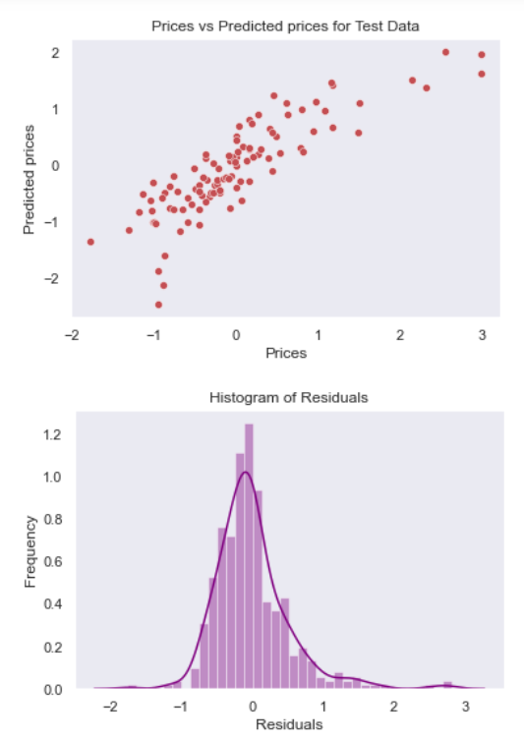
Linear Regression
Accuracy (R2) score for Linear Regression was around 75% on Train data and 71% on Test data.
This histogram indicates that random error is normally distributed,but the overall score for this model is low.
The Root Mean Squared Error is 0.46, which is higher compared to other models.

Slide 9
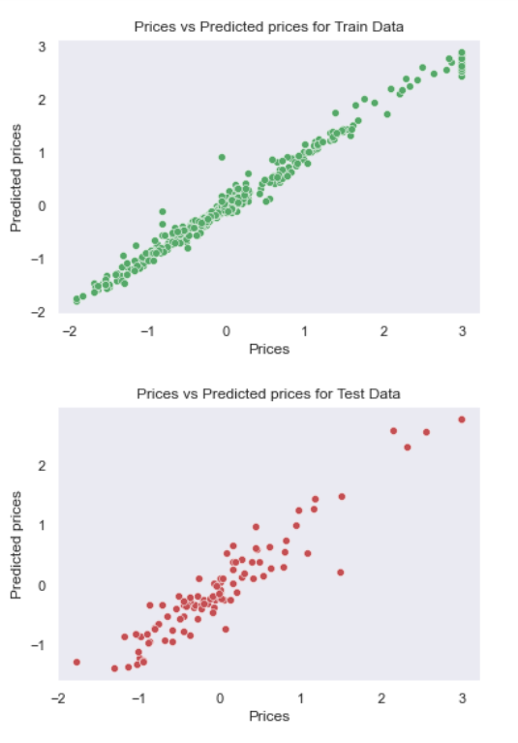
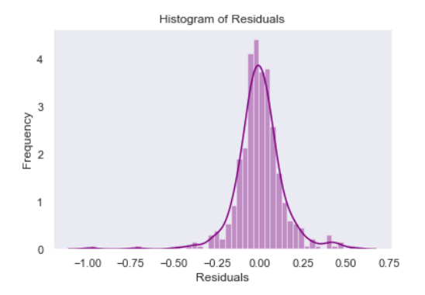
Random Forest Regressor
Accuracy (R2) score for Random Forest was around 97% on Train data and 90% on Test data.
This histogram indicates that random error is normally distributed, and this is a great model to proceed further with.
The Root Mean Squared Error is 0.26.
The model performs well on Train and Test data and the points are linearly distributed

Slide 10
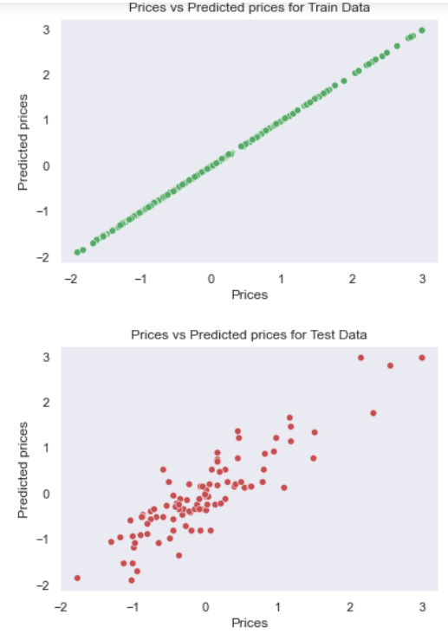
Decision Tree Regressor
The R2 Score for Train was 100% and for Test was 76%, this means that the model overfit the data.
As the model overfit we can add more data,simplify the model etc
Also the major sign of overfit is accuracy 100% on Train and comparatively less accuracy on Test.
The RMSE =0.42 around same as Linear Regression of 0.42

Slide 11
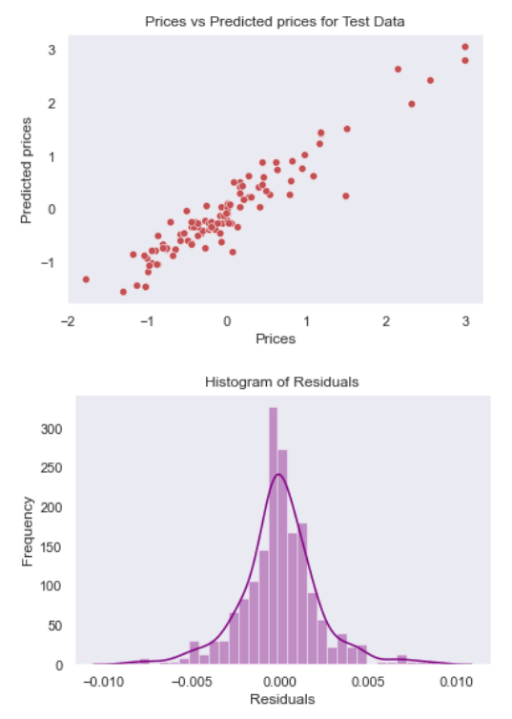
XGBoost Regressor (Extreme Gradient Boosting)
XGB was on par with Decision Tree with 99% Accuracy on Train and 90% on Train.
The model overfit the data, but the Histogram of residuals plot is approximately linear, we proceed assuming that the error terms are normally distributed.
The RMSE is 0.27

Slide 12
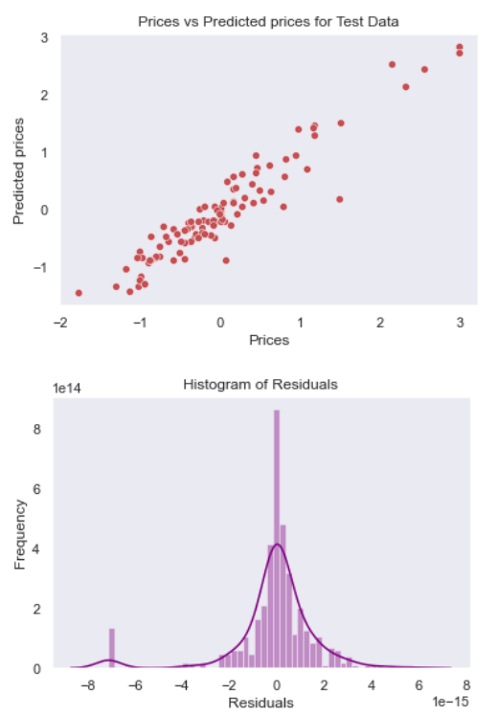
Extra Trees Regressor
Extra Tree Regressor along with XGBoost and Random Forest gave over 90% of accuracy for model testing and training.
The Histogram for residuals for Extra Tree is also linear.
RMSE was 0.27
Extra Tree provides us with feature importance, i.e the values that have the high correlation/impact on the output which were LSTAT and Average Rooms.

Slide 13
HyperTuning Random Forest
As Random Forest Regression was the best model with overall good scores, hypertuning this model can give better efficiency and lower RMSE.
Hyperparameter tuning is choosing a set of optimal hyperparameters for a learning algorithm.
A hyperparameter is a model argument whose value is set before the learning process begins.
Utilized : RandomizedSearchCV :
RandomizedSearchCV goes through only a fixed number of hyperparameter settings. It moves within the grid in random fashion to find the best set hyperparameters. This approach reduces unnecessary computation.
Parameters provided included : n_estimators,max_features,max_depth,min_samples_split,min_samples_leaf etc

Slide 14
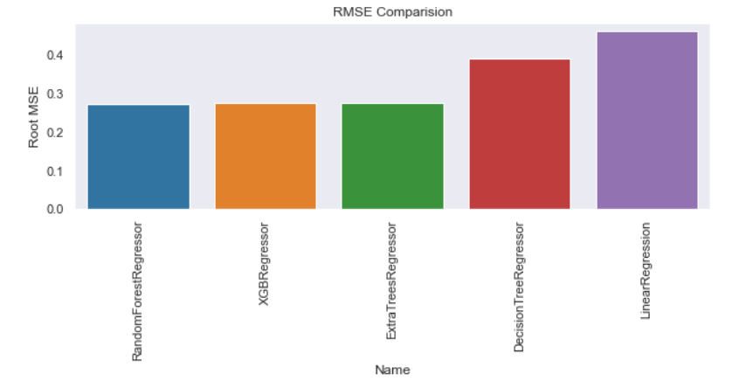
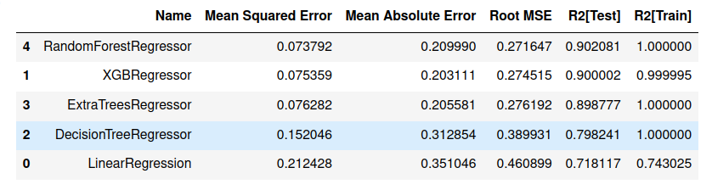
Results:
HyperTuned Random Forest Regression has the minimum Root Mean Squared Error, Mean Squared Error and Mean Absolute Error
The Accuracy for Train and Test is good for Random Forest,XGB and Extra Tree Regressot

Slide 15
Conclusion
We investigated the data,checking for data unbalancing,visualizing the features and understanding the relationship between different features.
Used train-test split to evaluate the model effectiveness to predict the target value i.e. the Price.
Looking at the results we can conclude:
As there are only 13 features, the model overfits easily, more information such as public transport access, parks et can be added.
Model can perform much better with more training data, this way we can also remove the outliers and can increase the efficiency.
The algorithm from this model may not be that effective today as the data is old and there is a huge change in prices, crime rates etc.

